Slide 1
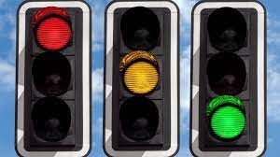
Automated Adaptive IR based Traffic Control

Slide 2

Batch no : 25
S. Srikanth - 18241A04A1
V. Sanjeev ram - 18241A04B9
A. Adarsh rao - 18241A0461
G. Akash - 19245A0413
Guided by : A. Sireesha (Asst . Professor , GRIET )

Slide 3
Objectives
Adaptive traffic lights based on density of the road
Traffic light priority control for emergency vehicles like ambulance , fire trucks , police vehicles etc.

Slide 4
LITERATURE SURVEY-I
Author WuHejun & Miao Changyun, discussed a traffic system in which wireless sensor network is used for traffic light control. It uses an adaptive traffic light control algorithm which works in three steps: vehicle detection, determination of green light sequence and calculation of light length. Vehicle detection detects and calculates traffic information in real-time. Green light sequence determination uses the traffic information to determine the next green light to the case in the most need. Light length calculation determines how long the green light will last for. This algorithm maximizes the traffic throughput and minimizing average waiting time at an intersection The problem with this system is that it is suitable to control traffic light in single intersection but it is not able to investigate traffic control problem of multi intersection.

Slide 5
LITERATURE SURVEY-II
Author Beijing, China Dongguan discussed Intelligent traffic light control system is design which is based on traffic flow is and uses camera, video capture module, software based on DSP , traffic light controller module and various group of traffic light. Camera used in this system captures real-time images of the various intersection, main software processes this images captures by camera module, and finally the processed digital video signals will is transmitted to the main DSP module, this processed signal is used to calculate traffic flow. The main DSP module uses this video signals instantaneously controls traffic light through the data sent by traffic light controller module according to the flow of traffic at the intersection, and hence increases the no. of capacity of vehicles crossing through the intersection. This system gives very correct detection of traffic flow and controlling traffic light will improve the intersection nodes crossing capacity, But as it uses hardware devices like camera and will increases the complexity as if the camera is not working properly and not capturing videos properly then the generated result will not give proper signal to the traffic controller module and this may create a problem and also the digital signal may take more time to process.

Slide 6
LITERATURE SURVEY-III
Author Josiane Nzouonta, Neeraj Rajgure, Guiling (Grace) Wang discussed the various model for ITS(Intelligent Transport system) for traffic control an Intelligent transportation systems (ITS) is the system which is widely used. ITS uses real-time forecasting of data. ITS uses various data forecasting model for forecasting data to their user. This real time data is a key for ITS system. This data need to be gather in every short-term condition of traffic at different lanes or intersection. For the collecting this real time data forecasting models is used This forecasting models provides the ability to collect or gather this short-term real data, and also supports proactive traffic transportation management and travel information services.

Slide 7
EXISTING SYSTEM
The existing systems have human interference and the timing of the signals is of long period and no proper solution given for emergency vehicles.
The absence of a comparison of vehicle concentrations in different portions of the road at a junction, despite the presence of a set time period of signal operation.
Even if the road is vacant and without vehicles, a fixed time period of green signal is received, which is of no value. Because there is no regular flow of vehicles from all roads at the intersection, this might result in significant traffic congestion. Human irritability rises, which could be one of the main causes of traffic offences like jumping red lights, speeding, and so on.

Slide 8
Proposed system
Various technologies have been proposed so far for real time adaptive traffic control system. Technologies like inductive looping and load cells requires in ground installation which increases deployment and maintenance cost. Individual systems have drawbacks which are needed to be solved to improve the efficiency of the system. In proposed system we have provided solution to adaptive congestion control mechanism.
Here Raspberry pi is our intelligent IOT gateway which performs the task of processing. We have used IR sensors for traffic density detection. A pair of transmitter and receiver performs this task of density detection. Pi-camera is used to capture images which is then processed using openCV to helmet detection. In addition to it RFID is used to detect entry of any emergency vehicle like fire brigade or ambulance.
The complete prototype can be divided into three modules – congestion control, emergency vehicle detection and reporting of stolen automobiles. One of the major drawback of existing traffic control system is that it is static. The proposed module gives green path time which is a function of traffic density. Traffic density is calculated by using a hybrid approach i.e. IR sensors and Image processing
The proposed model provides solution to the growing traffic congestion problem and can effectively replace the existing traditional methodologies or traffic control system. Since the green path time is a function of the traffic density it could be varied with the varying traffic densities and conditions. Clearance time calculation is adaptive and intelligent, in addition to this prioritization for emergency vehicles

Slide 9
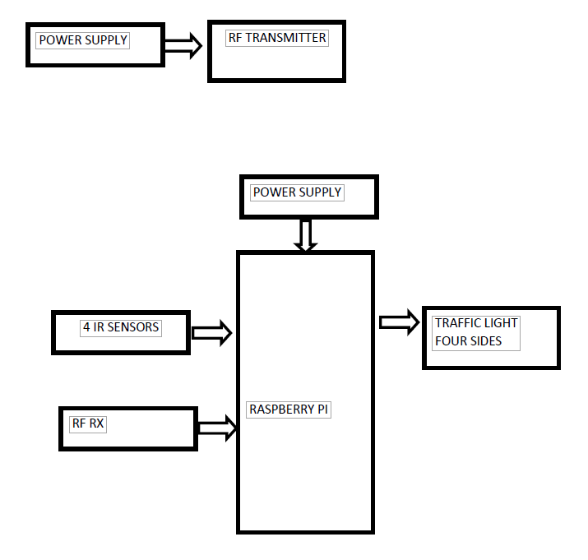
Block Diagram

Slide 10
Introduction
India is a developing country. Increase in personal vehicles comes with the development of a country parallel. This has led to rise in congestion in large cities. So, we need a better traffic management system.
The purpose of this project is to create a traffic system which is adaptive to the present traffic scenario. Usually, we have fixed average waiting time for all lanes. Our project suggests to change the average waiting time by monitoring the number of vehicles in a lane and giving priority to the lane in which emergency vehicles are present .
In this project , we will also implement number plate detection and helmet detection using machine learning algorithms. In this , when any vehicle is jumping the signal its number plate is detected and the details are stored in cloud and it also detects whether helmet is there or not.

Slide 11
Hardware requirements
Raspberry pi
IR sensors
RF transmitter and receiver
LEDs
Batteries for Power supply

Slide 12
Steps of approach
The purpose of this system is to improve efficiency of existing traffic system and reducing human intervention in controlling traffic .
In this project , we use raspberry pi interfaced with ir sensors , leds , pi camera ,
Ir sensors are placed beside the road and they detects the vehicles present on the road and measures the density .
Depending on density of road traffic lights will change adaptively .
We place RF transmitter to emergency vehicles and RF receiver is interfaced with raspberry pi and when emergency vehicle is in traffic the RF receiver receives the signal and makes the signal green for the emergency vehicle.

Slide 13
Steps of approach
We place serial camera that covers the road and it captures the vehicles.
With machine learning algorithms , from the captured videos the number plates are detected for those vehicles which jumps the signal when it is red and that is stored in cloud.
It also detects helmet , that is whether person is wearing helmet or not and vehicle number of person without helmet is also stored in cloud.

Slide 14
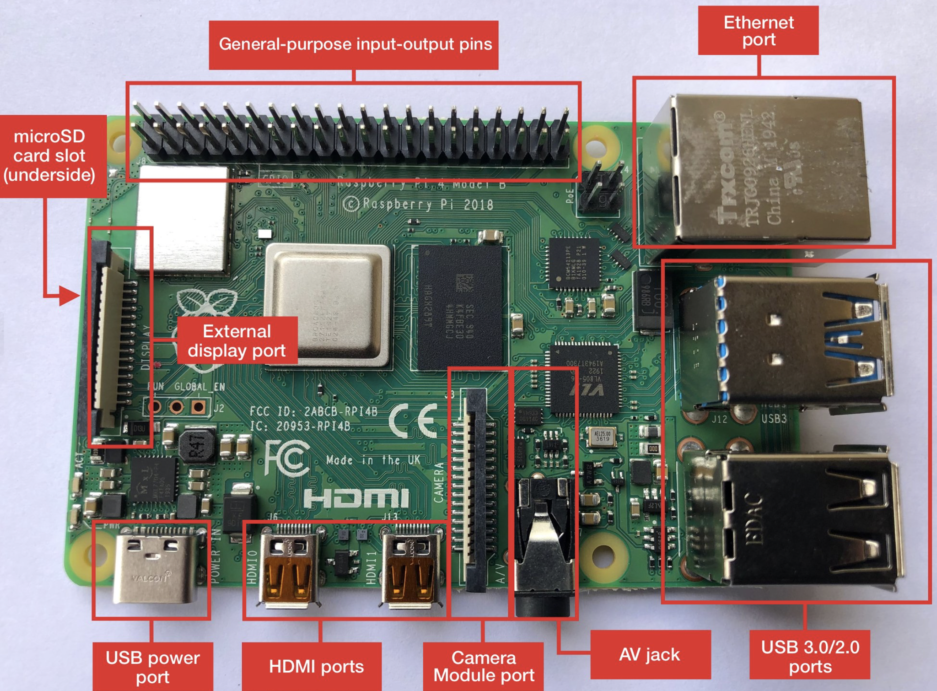
Raspberry pi
The Raspberry Pi is a low cost, credit-card sized computer that plugs into a computer monitor or TV and uses a standard keyboard and mouse. It is a capable little device that enables people of all ages to explore computing, and to learn how to program in languages like Scratch and Python.

Slide 15
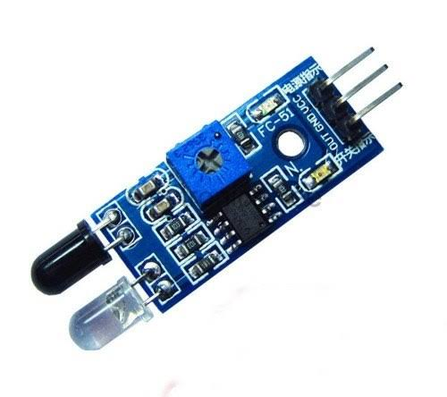
IR SENSOR
IR sensors are modules which detect the presence of objects before them.
It has 3 pins which are Vcc, GND and out pin.
The module is powered by 5V pin from Raspberry Pi and the out pin is connected to GPIO14 of Raspberry Pi

Slide 16
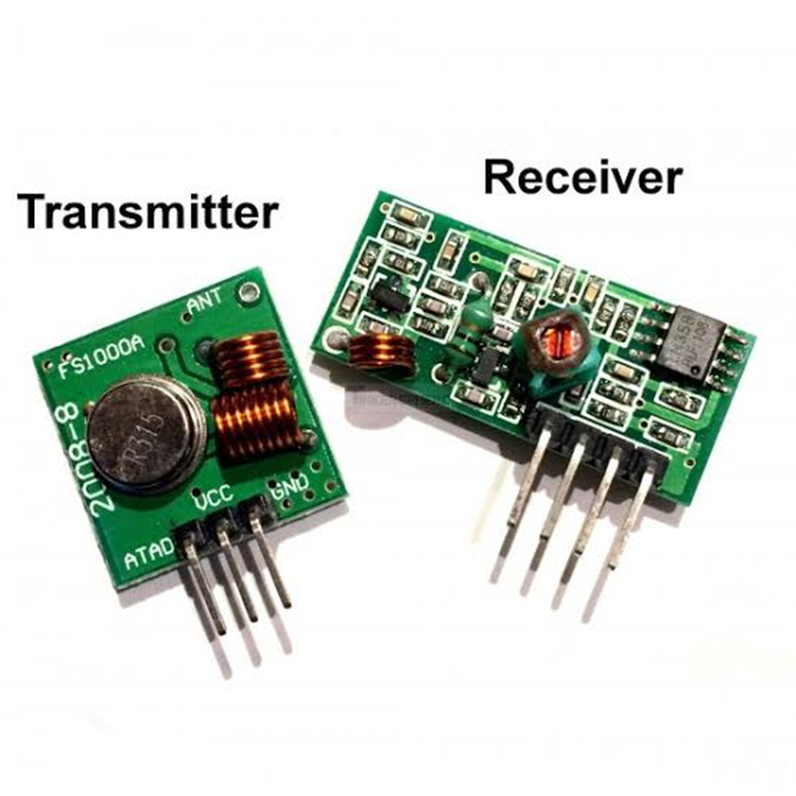
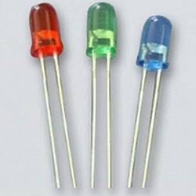
RF Transmitter
And receiver
LED

Slide 17
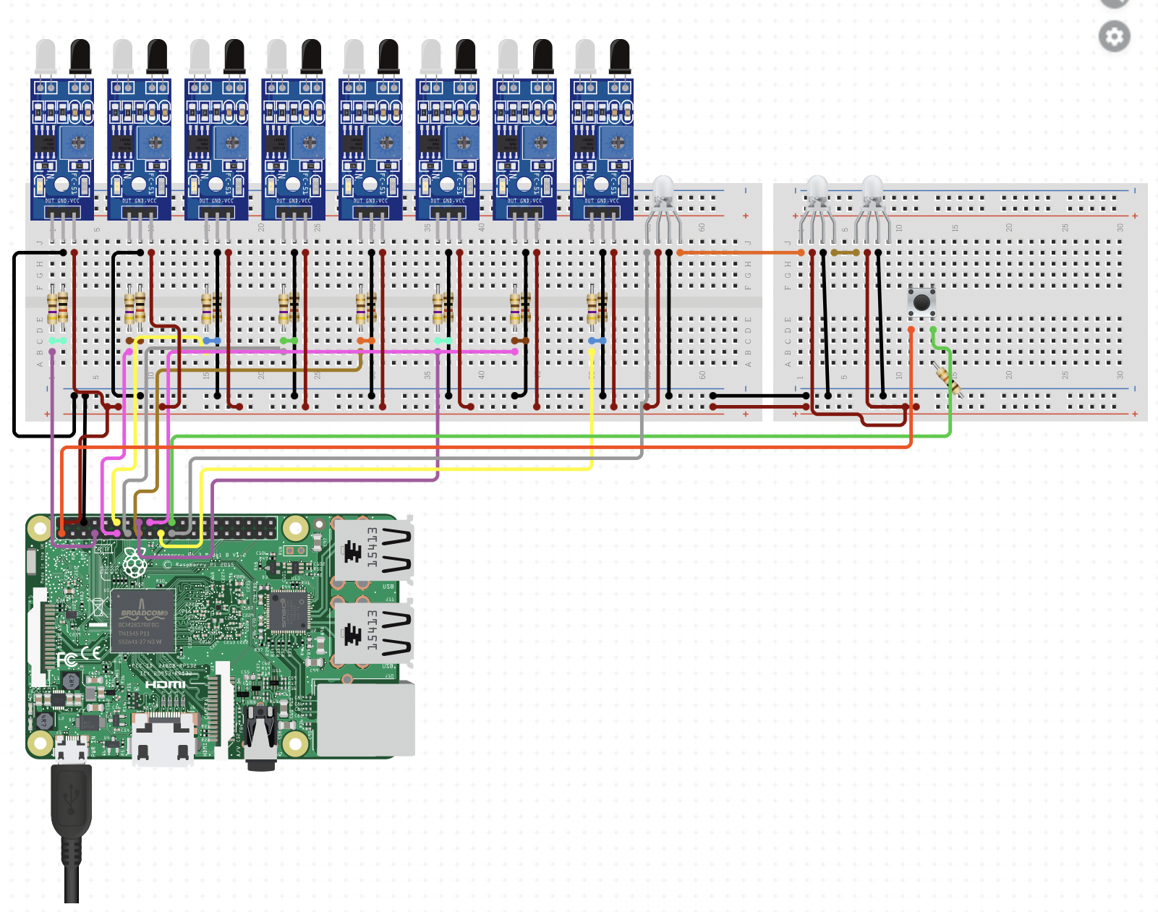
Circuit design

